Slide 1
Scenario Analysis Tools and Use
By: Justin Gale
March 19th 2024

Slide 2


About the author

Slide 3

The scenario
01
Company: Premium House Lights
Premium House Lights Inc. is an Ontario-based boutique company that sells and installs luxury lighting for upscale buildings and homes. The company operates an e-commerce website and a brick-and-mortar store, serving a loyal customer base.
02
The threat actor and known techniques
The 4c484c group is known from this scenario to use other peoples scripts and automation. They have a good understanding Linux commands, that when they are remotely accessing the database from the webserver, they are able to steal the data and cover their tracks up a bit.
03
What happened and why?
The companies customer data was stolen from the companies database and is being used to extort the company for 10 BTC (about 900000$)
04
How was the system compromised
The threat actor utilized a program for reconnaissance on the company website to upload a python script to gain remote access to the webserver. Using the webserver they accessed the database to steal customer data for use to extort Premium House Lights

Slide 4
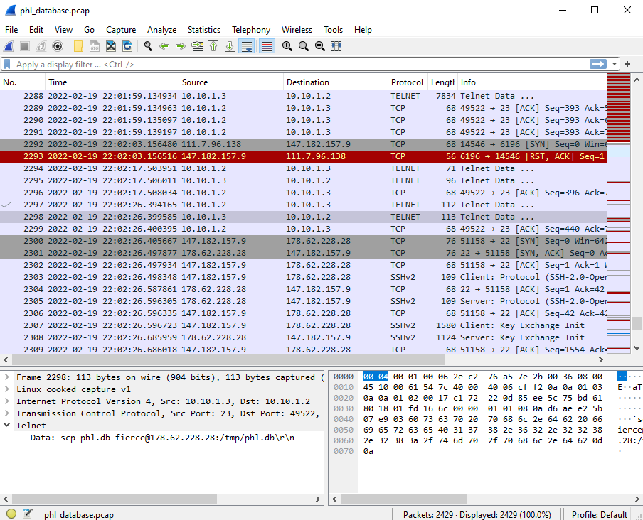
The Forensic Analysis Tools
Wireshark
Wireshark is like a high-tech detective tool for your computer network. It captures and analyzes the digital "conversations" happening between devices connected to the network, kind of like listening in on phone calls. With
Wireshark, you can see what data is being sent and received.

Slide 5
The Forensic Analysis Tools
Event logs definition and Access log example
Event log files are like a digital diary for your computer system. They keep track of important events that happen, like when someone logs into a computer, when a program crashes, or when a security issue is detected. These logs help IT teams understand what's happening on the system, troubleshoot problems, and keep everything running smoothly.
Event log files are like a digital diary for your computer system. They keep track of important events that happen, like when someone logs into a computer, when a program crashes, or when a security issue is detected. These logs help IT teams understand what's happening on the system, troubleshoot problems, and keep everything running smoothly.
The request to the website. This specific one is a get request to access uploads/http/1.1 with a 200 status code( The request was successful)
IP Address accessing the Webserver
Time of the access
138.68.92.163 - - [19/Feb/2022:21:58:55 -0500] "GET /uploads/ HTTP/1.1" 200 1115 "-" "curl/7.68.0"
138.68.92.163 - - [19/Feb/2022:21:59:04 -0500] "POST /uploads/shell.php HTTP/1.1" 200 2655 "-" "curl/7.68.0"
This is the post request to the website causing the first actual breach and starting the chain reaction that causes Premium house lights its customer data
This is the command prompt and version used to upload a script that allowed remote access of the webserver

Slide 6
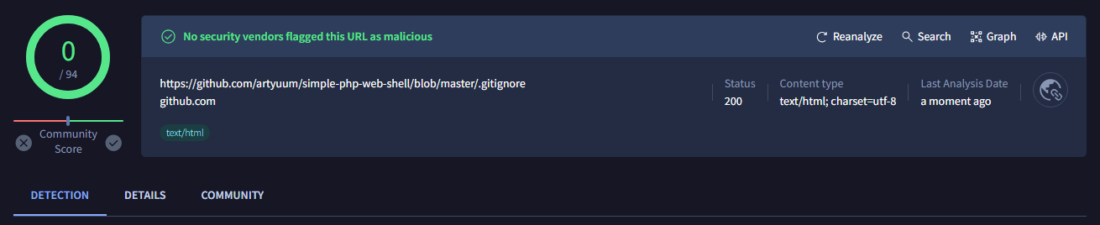
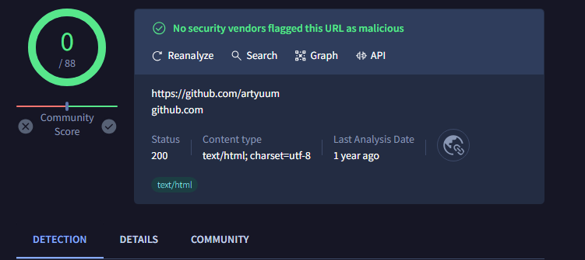
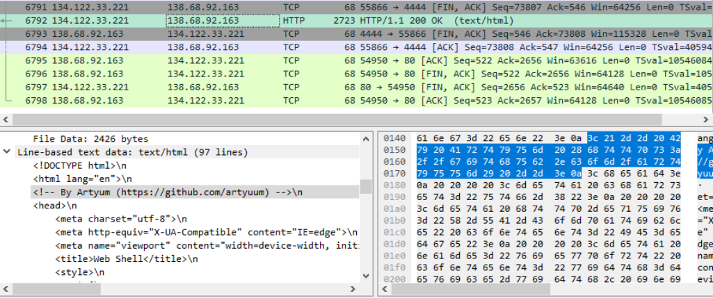
The Forensic Analysis Tools
VirusTotal
VirusTotal is like a digital security checkpoint for your files. It's an online service where you can upload a file, and it will be scanned by multiple antivirus engines to check if it's safe or if it contains any malicious code, like a hidden virus or malware. It's a helpful tool for businesses to quickly check the safety of files before opening them, to protect against cyber threats and keep their systems secure.

Slide 7
Thank you!
By: Justin Gale

